Slide 1
Cisco competition
Ilan Sirisky & Nir meir

Slide 2
The goal
Achieve the highest prediction scores while showing advanced data research capabilities in order to map out the right features in the best way fitting your machine learning model of choice.
Predict and classify malicious and benign API traffic utilizing our knowledge in data exploration and machine learning models.

Slide 3
Algorithm
We decided to use the Random Forest Classifier in our approach to the competition.
Random forests are an ensemble learning method for classification, regression and other tasks, that operate by constructing a multitude of decision trees at training time and outputting the class that is the mode of the classes (classification) or mean prediction (regression) of the individual trees.
A random forest classifier works by training many decision trees on random subsets of the features, and then averaging their predictions. This can help to reduce overfitting, since the decision trees are less likely to be correlated with each other.

Slide 4
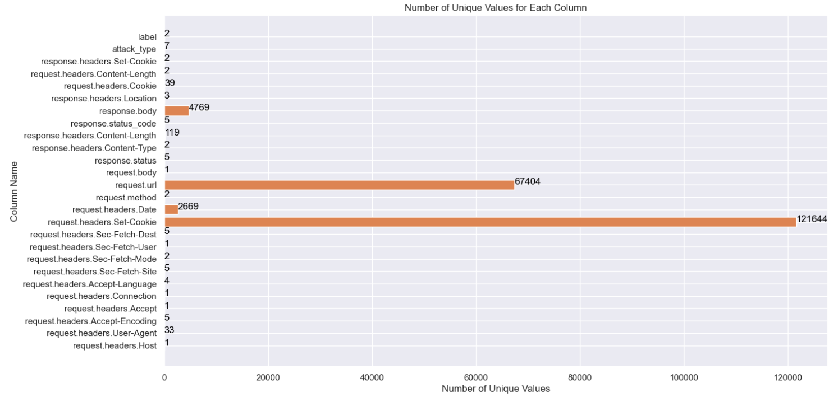
Features
Basically, we went through all the features that were given to us in the data sets and checked all their unique values and how they effect the label.
Here we can see the table with the number of unique values in each feature in data set 2.

Slide 5
Examples of findings
In the request.headers.Content-Length feature we saw that most of the data is nan (doesn’t exist), but the rest is ‘0’ and indicates that the label is “Malware”. And the attack type is ‘Cookie Injection’.
In the request.headers.Cookie feature we that most of the data is none, but the rest contained a string with ‘username=‘ and random characters after that. We found out that all the values with ‘username=‘ were labeled as “Malware”.
In the response.status and response.status_code features we saw that they had the same values, one feature had them as a string and the other as a number. We checked that they are the same and decided to delete one of them.

Slide 6
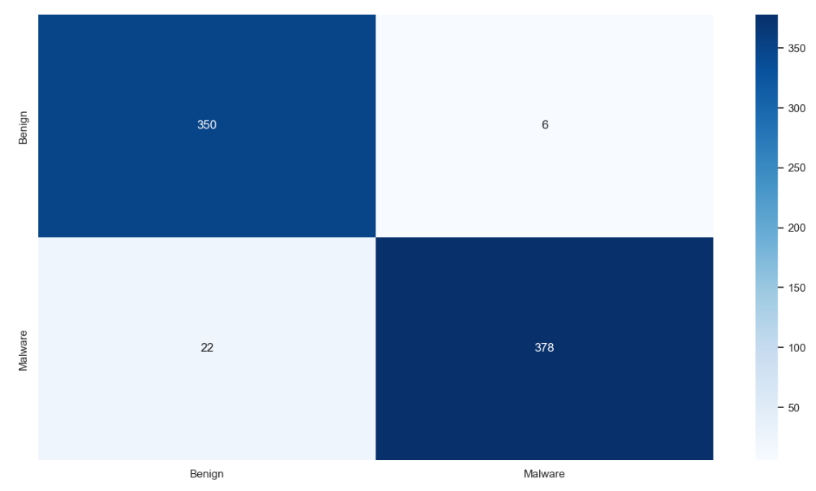
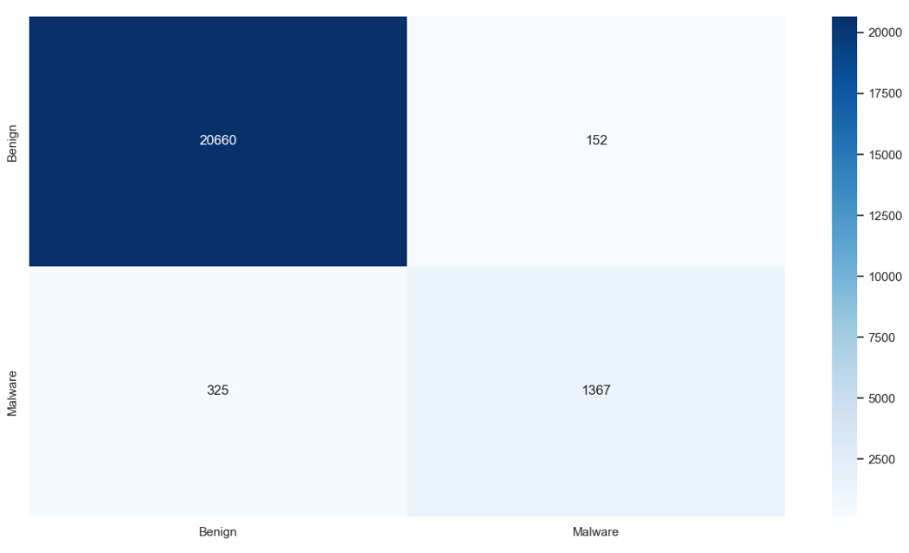
Confusion matrices - label
Data set 1
Data set 2

Slide 7
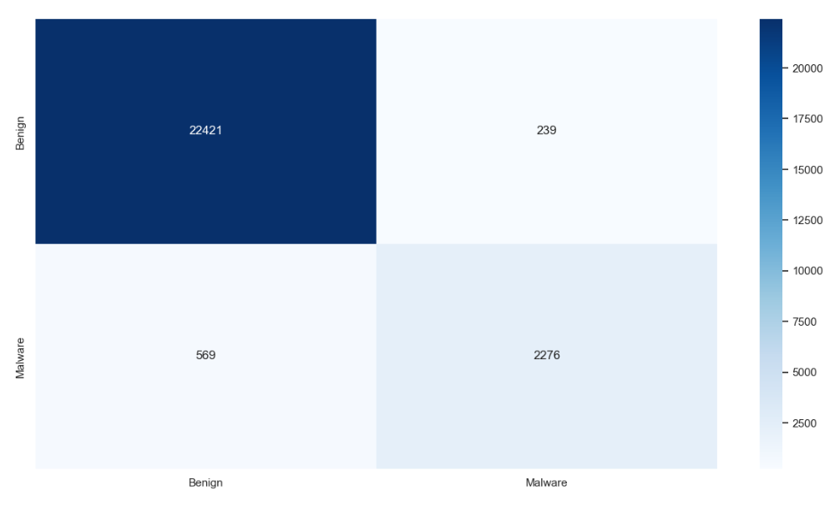
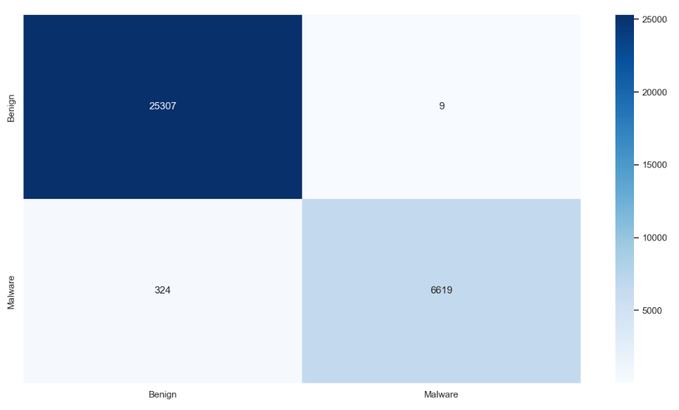
Confusion matrices - label
Data set 3
Data set 4

Slide 8
Results - Label
Data set​ | Accuracy | Precision | Recall | F1-Score
1 | 0.9523 | 0.9540 | 0.9521 | 0.9522
2 | 0.9795 | 0.9394 | 0.9108 | 0.9245
3 | 0.9592 | 0.9815 | 0.9641 | 0.9726
4 | 0.9973 | 0.9983 | 0.9937 | 0.9960

Slide 9
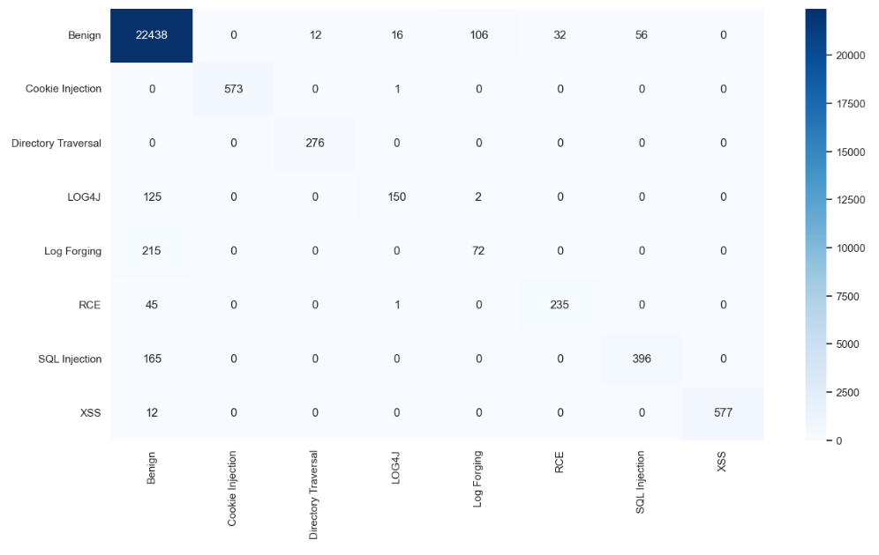
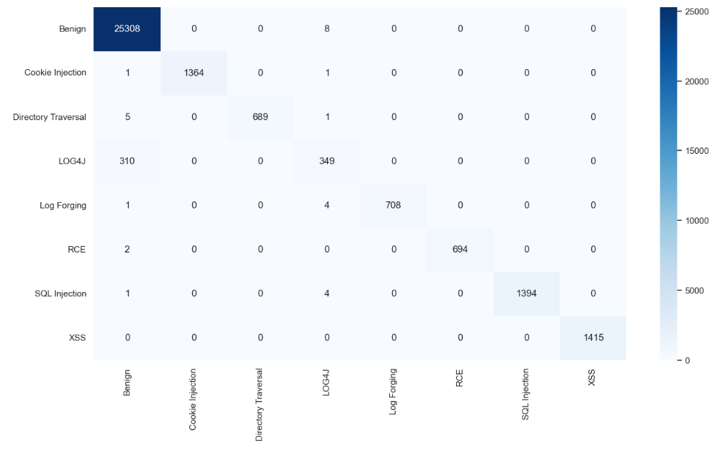
Confusion matrices – Attack type
Data set 3
Data set 4

Slide 10
Results – Attack type
Data set​ | Accuracy | Precision | Recall | F1-Score
3 | 0.9886 | 0.9640 | 0.9215 | 0.9412
4 | 0.9972 | 0.9986 | 0.9829 | 0.9903

Slide 11
Leaderboard placements
Data set | Placement
1 - Label | 17
2 - Label | 17
3 - Label | 13
4 - Label | 13
3 – Attack type | 12
4 – Attack type | 10

